Slide 1
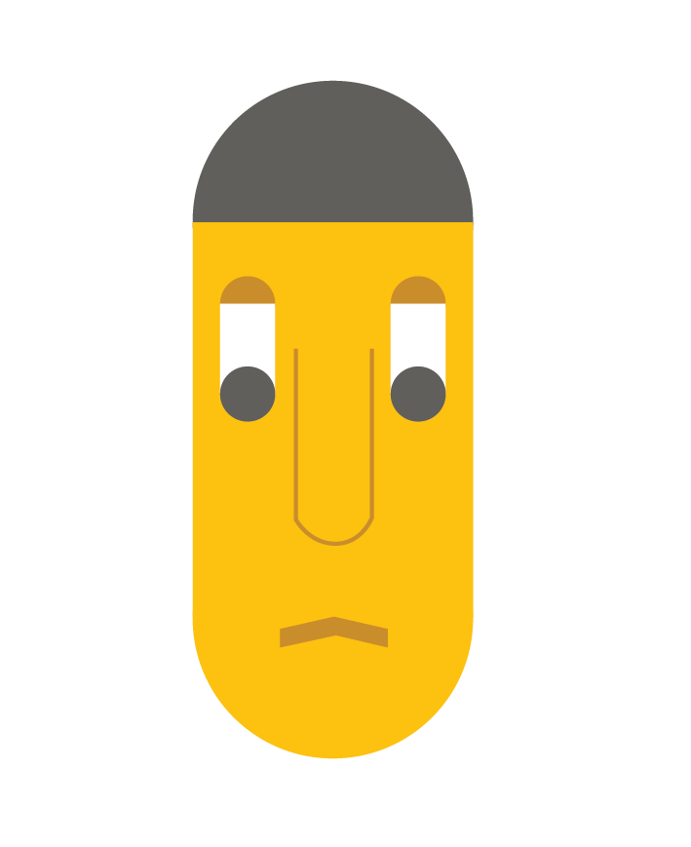
Life happens
Chronic disease management
Team HealthSweet

Slide 2
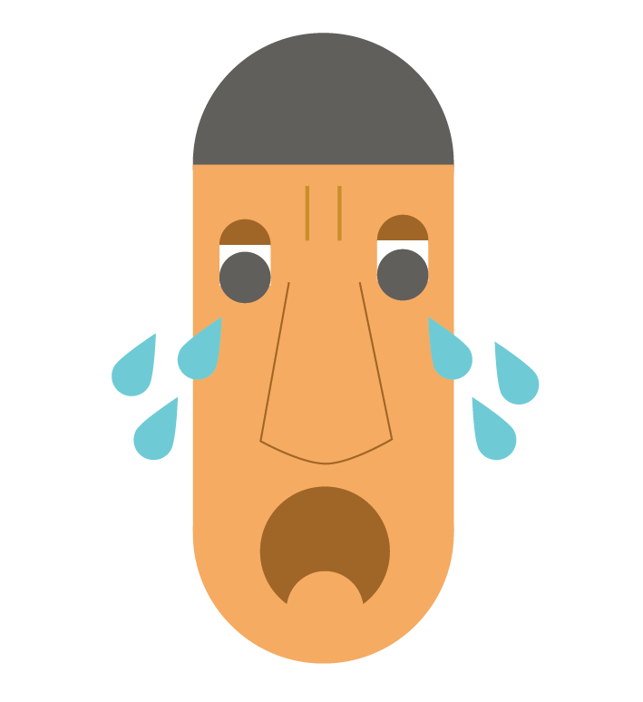
Chronic diseases
cause depression

Slide 3
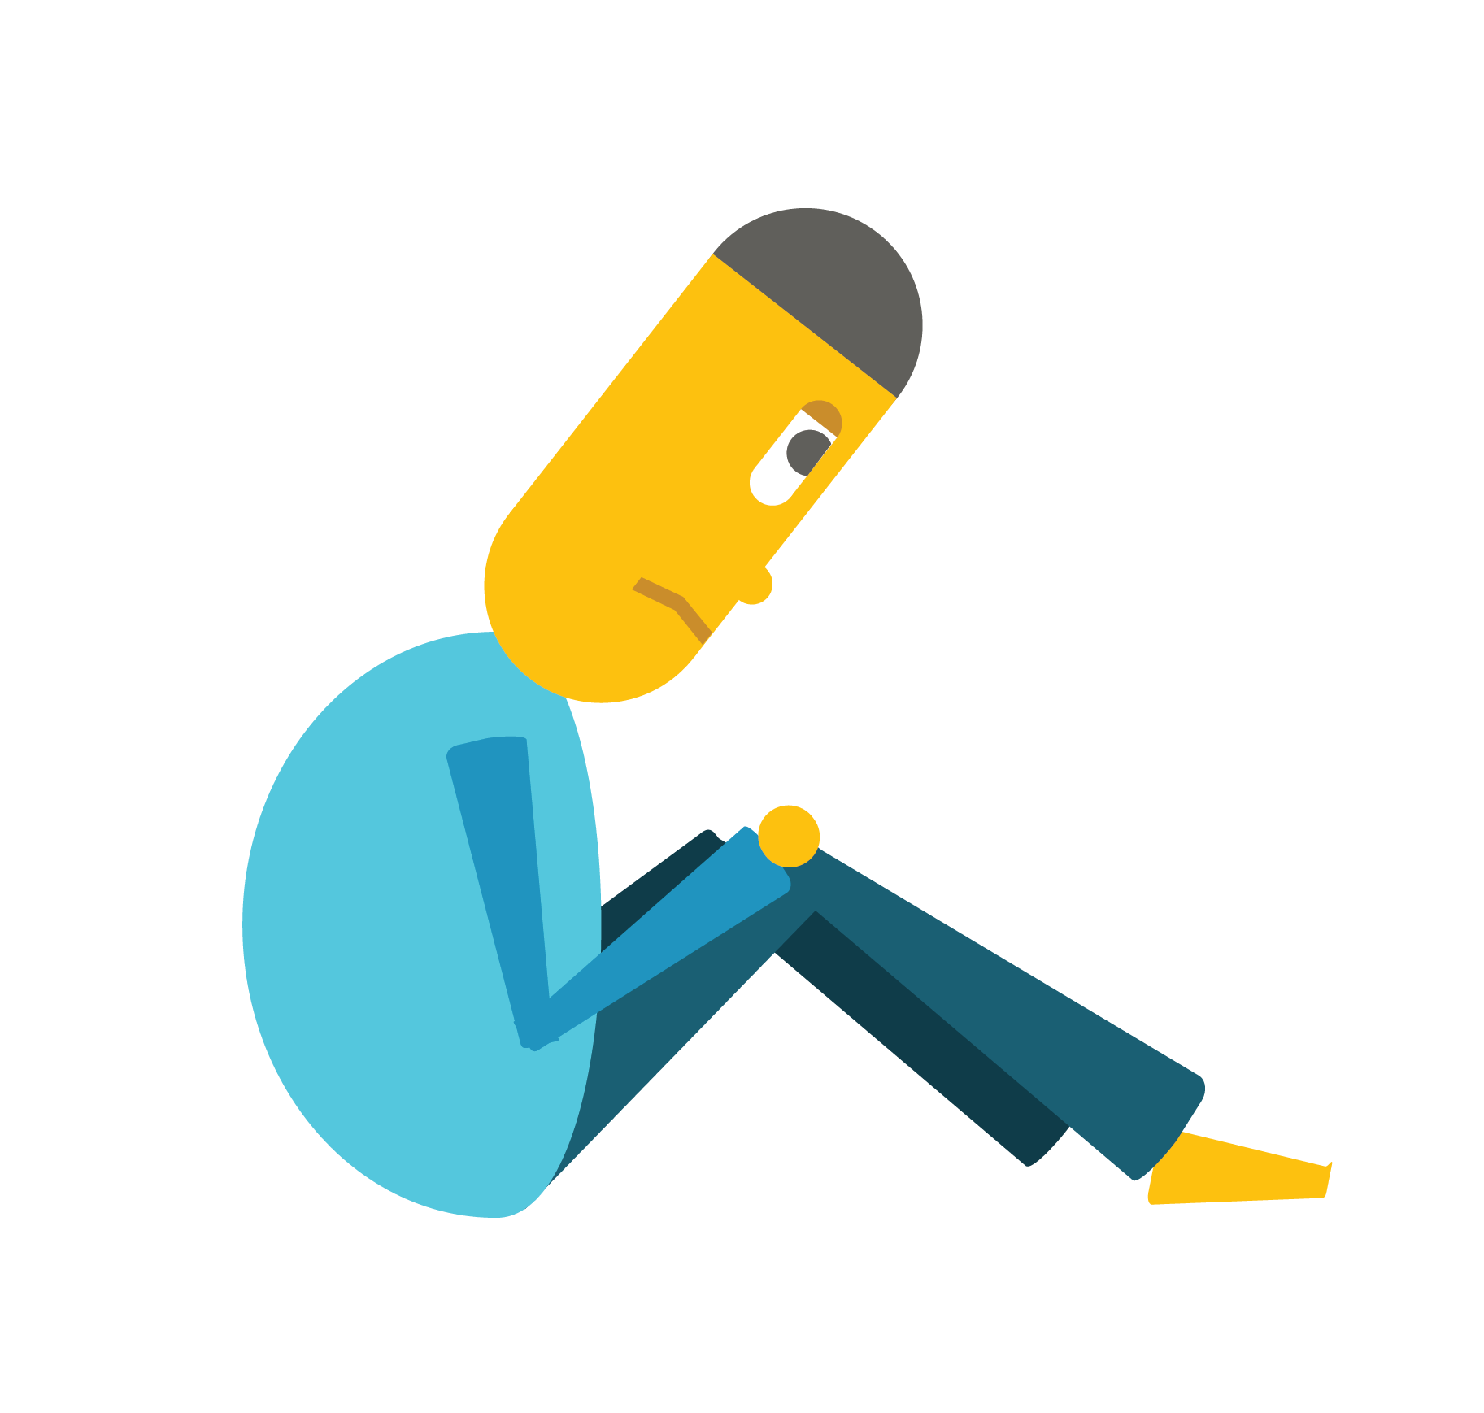
Depression
causes worsening of physical condition

Slide 4
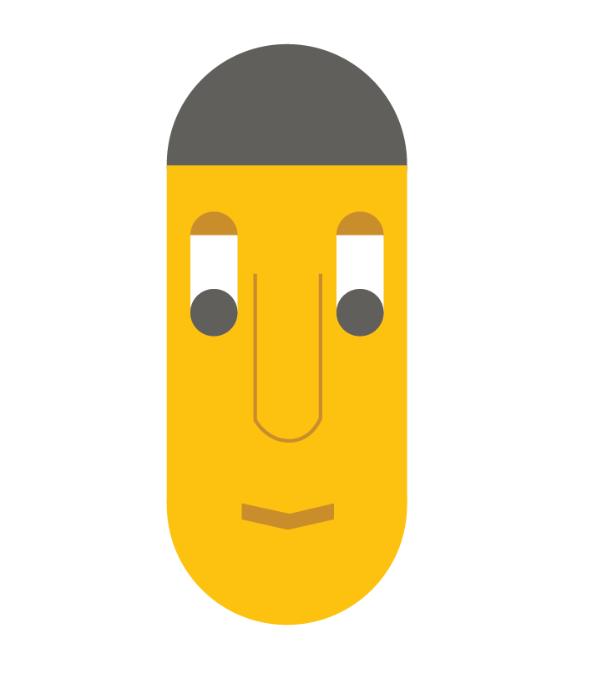
Introducing
happ

Slide 5
happ
Covers patient journey through
Treatment
Recovery
Home care

Slide 6
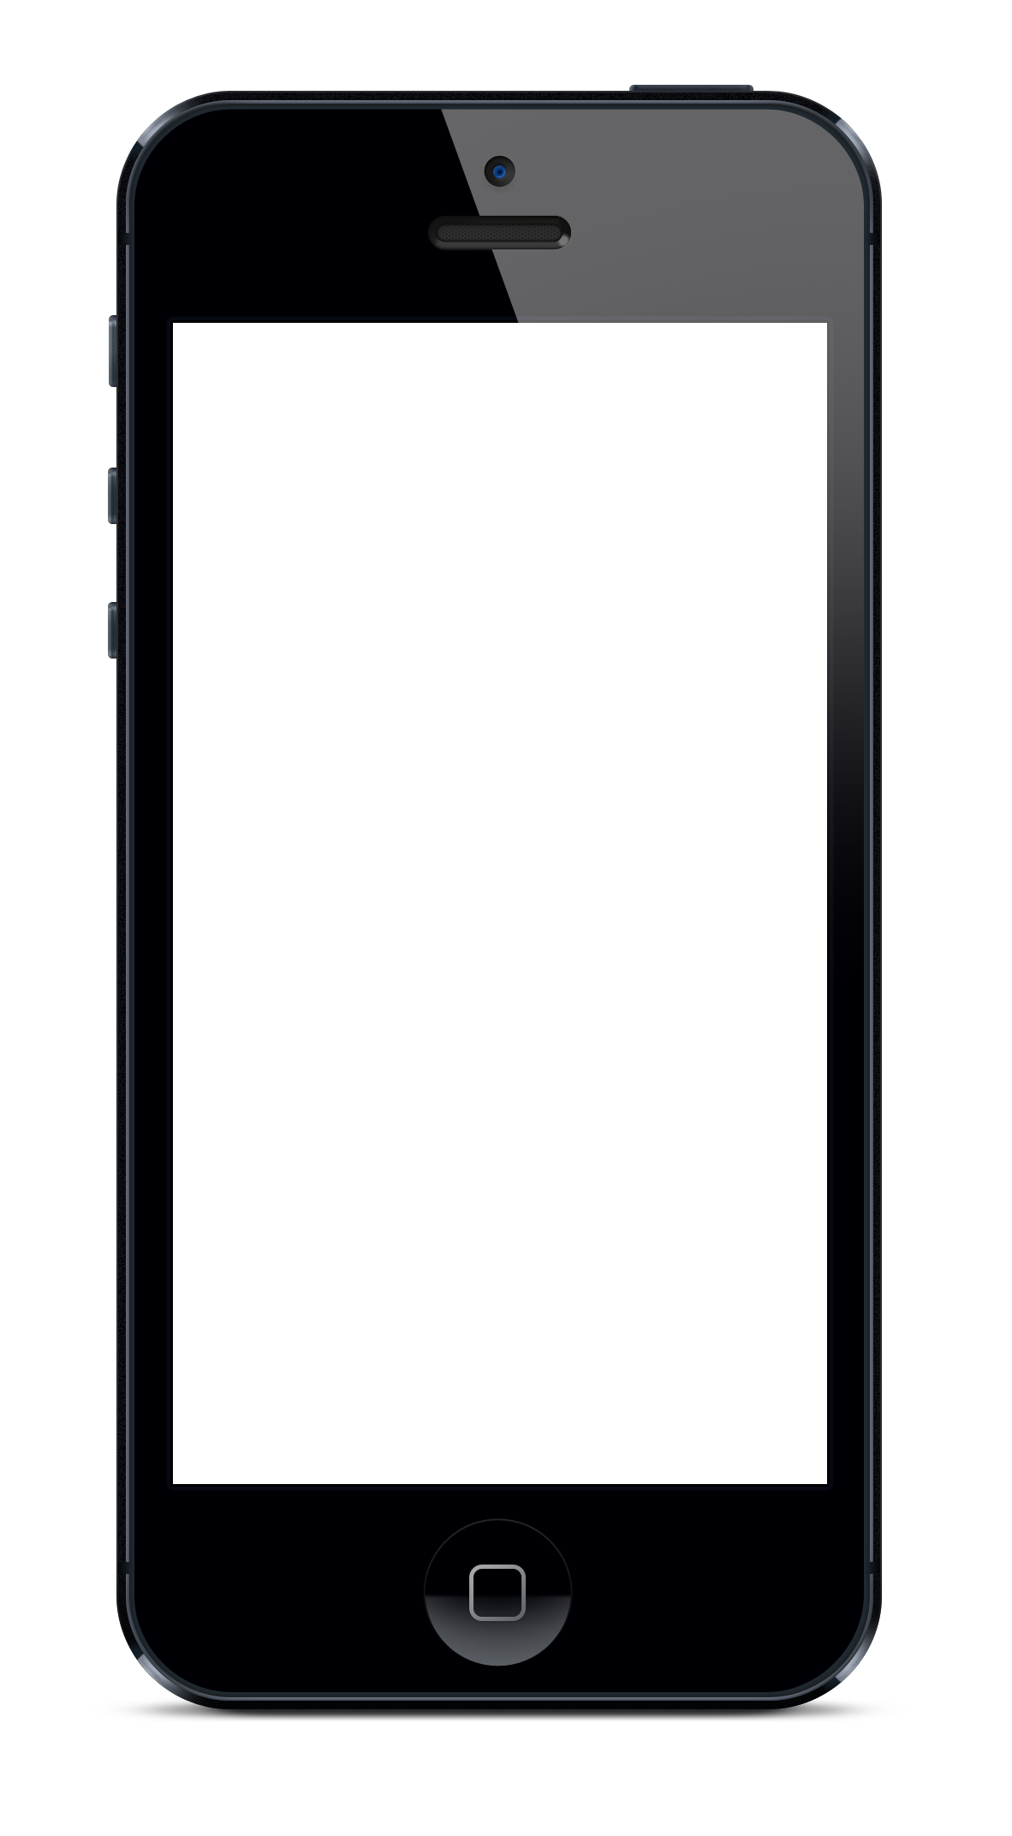
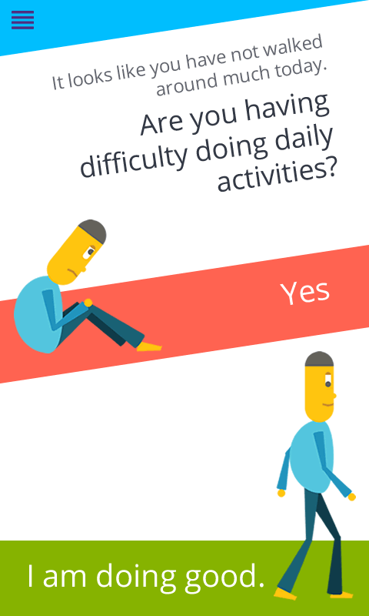
Tracks patient activity
# of steps
Sleep
Social network activity
Confirms with patient
If patient is really having some trouble

Slide 7
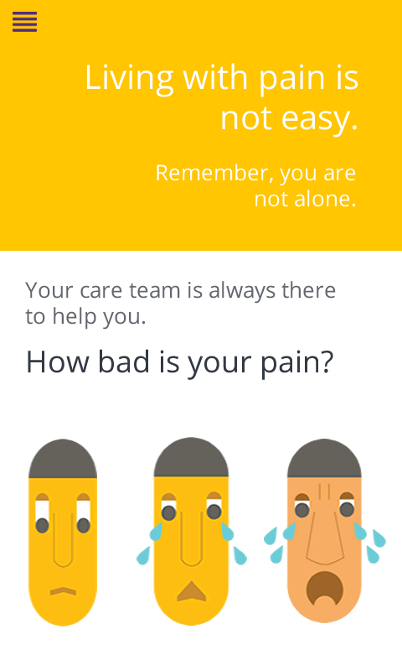
Identifies the gravity of problem
Pain scale
Mood scale

Slide 8
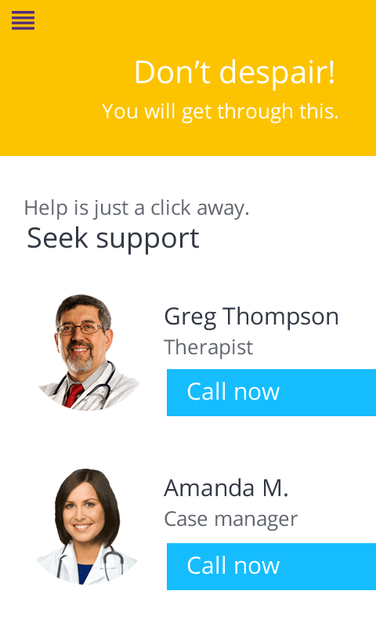
Reports pain to doctor
So doctor can adjust treatment (may include adjustments to pain medication dosage)

Slide 12
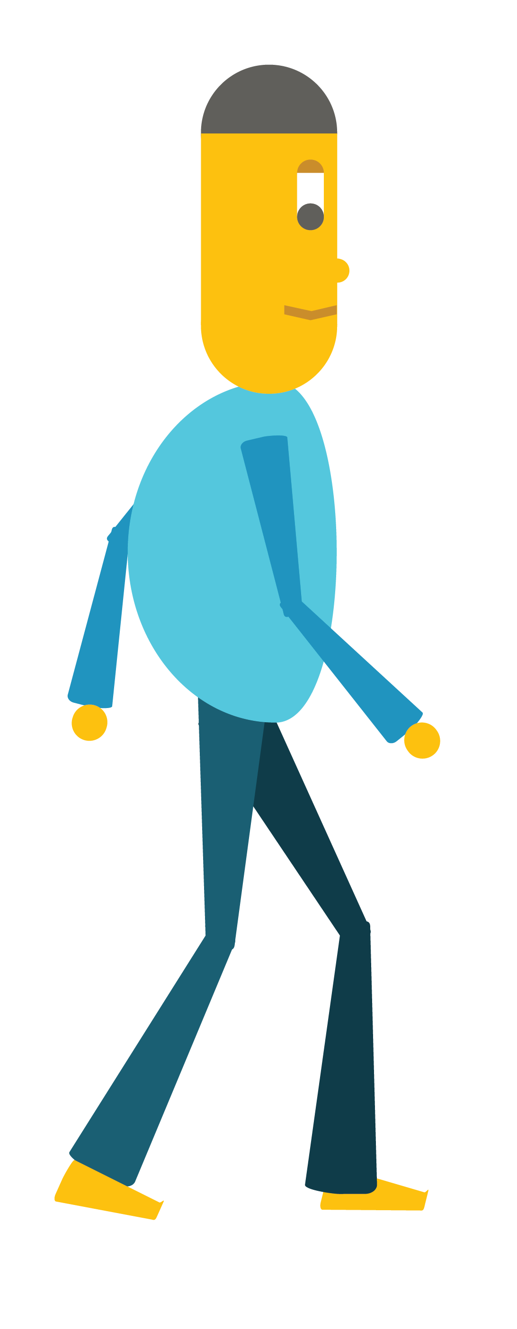
Don’t let chronic disease to stop you from living a fuller life
Get going

